Slide 1
Exception

Slide 2
Outline
Exception
The try-catch statement
Throw exception
The exception class hierarchy
User-defined exception

Slide 3
Errors in program
A program can have three types of errors:
  Compile-time errors: The compiler will find syntax errors and other basic problems
  Run-time errors: A problem can occur during program execution, such as trying to divide by zero, which causes a program to terminate abnormally
  Logical errors: A program may run, but produce incorrect results, perhaps using an incorrect formula
1-<number>

Slide 4



What is an exception?
If an error is encountered while executing a program, an exception occurs
ERROR !!
example :
4 / 0 =
An exception is an event that occurs during the execution of a program that disrupts the normal flow of instructions
Some exceptions: a user has entered invalid data, a file that needs to be opened cannot be found, a network connection has been lost in the middle of communications, or the JVM has run out of memory,…

Slide 5
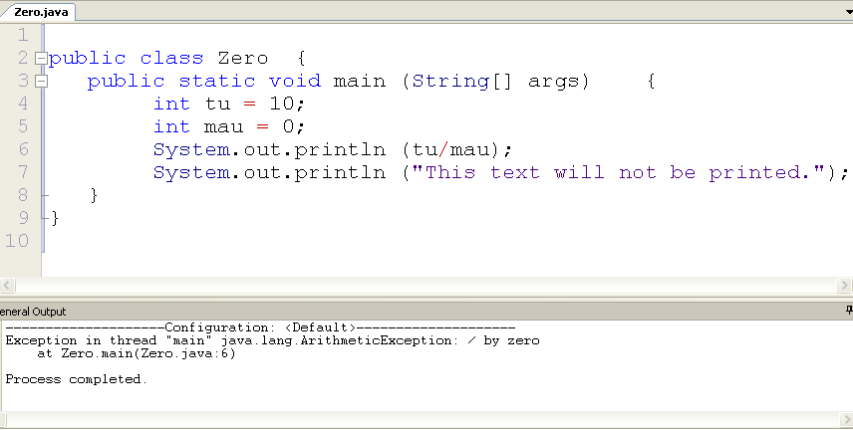
Example 1: exception devide by zero
An exception occurs at line 6
Notes:
public class Zero {
public static void main (String[] args) {
int tu = 10;
int mau = 0;
System.out.println (tu/mau);
System.out.println ("This text will not be printed.");
}
}

Slide 6
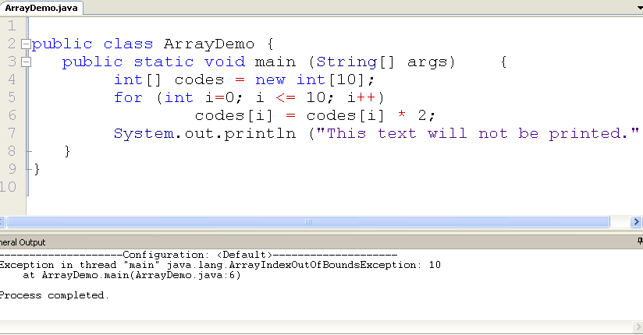
Example 2: exception out of index
Notes:
public class ArrayDemo {
public static void main (String[] args) {
int[] codes = new int[10];
for (int i=0; i <= 10; i++)
codes[i] = codes[i] * 2;
System.out.println ("This text will not be printed.");
}
}

Slide 7
Outline
Exception
The try-catch statement
Throw exception
The exception class hierarchy
User-defined exception

Slide 8
try-catch
try
{
// statements that may throw an exception
}
catch (ExceptionType ex)
{
// statements to process an exception
}
If any of the code inside the try block throws an exception, then
  The program skips the remainder of the code in the try block;
  The program executes the handler code inside the catch clause
If none of the code inside the try block throws an exception, then the program skips the catch clause

Slide 9
Example: catch exception devide by 0
public class Zero {
public static void main (String[] args) {
try {
int tu = 10;
int mau = 0;
System.out.println (tu/mau);
System.out.println ("This text will not be printed.");
}
catch (ArithmeticException e) {
System.out.println ("Không thể chia cho 0");
}
}
}

Slide 10
Example: catch exception out of index
public class ArrayDemo {
public static void main (String[] args) {
try {
int[] codes = new int[10];
for (int i=0; i <= 10; i++)
codes[i] = codes[i] * 2;
System.out.println ("This text will not be printed.");
}
catch (ArrayIndexOutOfBoundsException e) {
System.out.println (“Chỉ số truy cập vượt quá kích thước mảng”);
}
}
}

Slide 11
Catching multiple exceptions
A try block is followed by one or more catch clauses
  When an exception occurs, processing continues at the first catch clause that matches the exception type
try {
// statements that may throw an exception
}
catch(ExceptionType1 e1) {
// Catch block
}
catch(ExceptionType2 e2) {
// Catch block
}
catch(Exception e3) {
// Catch block
}
Notes:
Cho ví dụ

Slide 12
try-catch-finally
try
{
// statements that may throw an exception
}
catch (ExceptionType e1)
{
// statements to process an exception
}
finally
{
// statements always are executed
}
The statements in the finally clause always are executed
  If no exception is generated, the statements in the finally clause are executed after the statements in the try block complete
  If an exception is generated, the statements in the finally clause are executed after the statements in the appropriate catch clause complete

Slide 13
Example: try-catch-finally
import java.util.Scanner;
class FinallyDemo{
public static void main (String args[]){
String name; int no1, no2;
try {
Scanner sc = new Scanner (System.in);
name = new String("Aptech Limited");
System.out.print("Input No1: "); no1 = sc.nextInt();
System.out.print("Input No2: "); no2 = sc.nextInt();
System.out.println(name);
System.out.println("Division Result is: " + no1/no2);
xu ly xxxx bỏ khong viet ma viet trong finally
}
catch (ArithmeticException e) {
System.out.println("Cannot Divide by zero");
xu ly xxxx bỏ khong viet ma viet trong finally
}
catch (InputMismatchException e) {
System.out.println("You must input an integer");
xu ly xxxx} bỏ khong viet ma viet trong finally
finally {
xu ly xxxx viet 1 lan
name = null; // clean up code
System.out.println("Finally executed");
}
}
}

Slide 14
Methods used in exception object
getMessage(): contains information about the nature of the exception
printStackTrace(): prints out the cause of exception and also the line in the code which generated it
try{
int tu = 10;
int mau = 0;
System.out.println (tu/mau);
System.out.println ("This text will not be printed.");
}
catch (ArithmeticException e) {
System.out.println ("The exception message is: " + e.getMessage());
System.out.println ("The call stack trace:");
e. printStackTrace();
}

Slide 15
Exception propagation
An exception can be handled at a higher level if it is not appropriate to handle it where it occurs
Exceptions propagate up through the method calling hierarchy until they are caught and handled or until they reach the level of the main method
Example:
  See Propagation.java
  See ExceptionScope.java
Notes:
Propagation: su lan truyen

Slide 16
Propagation.java
public class Propagation {
public static void main (String[] args) {
ExceptionScope demo = new ExceptionScope();
System.out.println("Program beginning.");
demo.level1();
System.out.println("Program ending.");
}
}

Slide 17
ExceptionScope.java
public class ExceptionScope
{
public void level1()
{
System.out.println("Level 1 beginning.");
try {
level2();
}
catch (ArithmeticException er)
{
System.out.println ();
System.out.println ("The exception message is: " + er.getMessage());
System.out.println ();
System.out.println ("The call stack trace:");
er.printStackTrace();
System.out.println ();
}
System.out.println("Level 1 ending.");
}
public void level2()
{
System.out.println("Level 2 beginning.");
level3 ();
System.out.println("Level 2 ending.");
}
public void level3 ()
{
int numerator = 10, denominator = 0;
System.out.println("Level 3 beginning.");
int result = numerator / denominator;
System.out.println("Level 3 ending.");
}
}

Slide 18
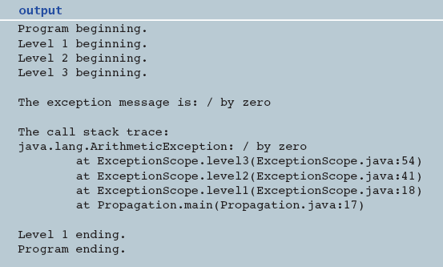
Output

Slide 19
Outline
Exception
The try-catch statement
Throw exception
The exception class hierarchy
User-defined exception

Slide 20
The throw statement
Exceptions are thrown using the throw statement
Throw exception when:
  You want to change the exception type
  You want to make an exception occur
    Usually using inside an if statement
    Example: ThrowExceptionDemo1.java
  You want that a method can throw an exception
    Place the throw statement at the header of the method
throw new ExceptionType();
throw exceptionReference;
try {
access the database
} catch (SQLException e) {
throw new ServletException("database error");
}

Slide 21
Example: ThrowExceptionDemo.java
public static void main (String[] args) {
try {
final int MIN = 25, MAX = 40;
Scanner scan = new Scanner (System.in);
System.out.print ("Enter an integer value between " + MIN + " and " + MAX + ", inclusive: ");
int value = scan.nextInt();
if (value < MIN || value > MAX)
throw new Exception(); // make an exception
else
System.out.println("Gia tri nhap hop le");
System.out.println ("End of main method."); // may never be reached
}
catch( Exception x ) { // catch the exception
System.out.println("Number is not valid.");
}
}

Slide 22
Outline
Exception
The try-catch statement
Throw exception
The exception class hierarchy
User-defined exception

Slide 23
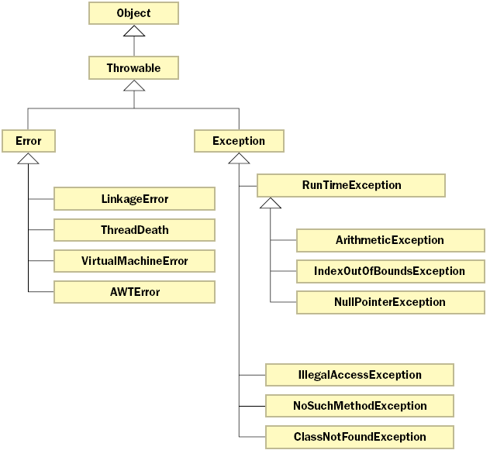
The exception class hierarchy
Part of the Error and Exception class hierarchy
Notes:
- Classes that define exceptions are related by inheritance, forming an exception class hierarchy
- All Error and Exception classes are descendents of the Throwable class
- Error là một loại lỗi nằm ngoài phạm vi ứng dụng, được java trả về trong đối tượng java.io.IOError. Ví dụ ứng dụng mở một tập tin thành công nhưng khi đọc dữ liệu lại không đọc được do ổ cứng bị hỏng một vài sector vật lý, …
- Khi lập trình trong java, chúng ta cần quan tâm đến Exception hierarchy
A programmer can define an exception by extending the Exception class or one of its descendants

Slide 24
Checked and unchecked exceptions
Any exception that derives from class Error or class RuntimeException and any of its subclasses are called an unchecked exception
  With an unchecked exception, the compiler doesn't force the programmers either to catch the exception or declare it in a throws clause
All other exceptions are considered checked exceptions
  A checked exception must be caught or it must list in a throws clause of the method header
    IOException is a checked exception
Notes:
Unchecked exception thường được hiểu là những exception được sinh ra do lỗi logic khi lập trình và được trả về lúc runtime
Checked exception là loại ngoại lệ phổ biến sử dụng để kiểm tra những lỗi phổ biến trong lúc biên dịch ví dụ bạn truy xuất một tập tin không tồn tại trên ổ đĩa thì bạn sẽ nhận được một java.io.FileNotFoundException
Declaring Checked Exceptions: core java chapter 11

Slide 25
Outline
Exception
The try-catch statement
Throw exception
The exception class hierarchy
User-defined exception

Slide 26
User-defined exceptions
We can define our own exceptions by deriving a new class from Exception or one of its descendants
User defined exception classes that are created will have all methods of Throwable class
Throwable()
constructs a new Throwable object with no detailed message
Throwable(String message)
constructs a new Throwable object with the specified detailed message. By convention, all derived exception classes support both a default constructor and a constructor with a detailed message
String getMessage()
gets the detailed message of the Throwable object

Slide 27
Example 1: OutOfRangeException.java
public class thayDatOutOfRangeException extends Exception
{
public thayDatOutOfRangeException ()
{
super ("Gia tri nhap vao nam ngoai khoang quy dinh."); //message
}
public thayDatOutOfRangeException (String mess)
{
super (mess); //message
}
}
Notes:
Example: We create the OutOfRangeException class by extending the Exception class

Slide 28
Example 1: (cont.)
import java.util.*;
class Main{
public static void main (String[] args) {
try{
final int MIN = 25, MAX = 40;
System.out.print ("Nhap vao mot gia tri trong doan " + MIN + " va " + MAX);
Scanner nhap = new Scanner(System.in);
int value = nhap.nextInt();
if (value < MIN || value > MAX)
throw new thayDatOutOfRangeException ();
else
System.out.println ("Gia tri nhap hop le");
}
catch (thayDatOutOfRangeException e) {
System.out.println (e.getMessage());
}
}
}

Slide 29
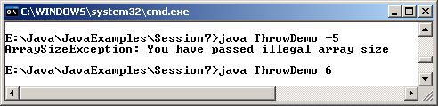
Example 2: UserDefinedException.java
class ArraySizeException extends NegativeArraySizeException
{
public ArraySizeException() // constructor
{
super("You have passed illegal array size");
}
}
class UserDefinedException
{
int size, array[];
public UserDefinedException(int val)
{
size = val;
try
{
checkSize();
}
catch(ArraySizeException e)
{
System.out.println(e);
}
}
Output
void checkSize() throws ArraySizeException
{
if (size < 0)
throw new ArraySizeException();
array = new int[3];
for (int count = 0; count < 3; count++)
array[count] = count+1;
}
public static void main(String arg[])
{
new UserDefinedException(Integer.parseInt(arg[0]));
}
}

